Slide 1
Interactive Chatbot
Deep Learning Assignment

Slide 2
Team Details
Girish Kumar M P – 106119034
Mohan Kumar G – 106119078
M Shriram – 106119080

Slide 3
Problem Statement
To create an interactive chatbot

Slide 4
Tools and Libraries used
Tensorflow
Keras
Sklearn
Pickle
NLTK
Pandas
Numpy
VS Code

Slide 5
The Approach
For this project, we created an interactive chatbot that replies to the given message string using LSTMs and sentiment classification
A sentiment is attached to each chat message
An LSTM model is trained for each sentiment
The reply/prediction to the given message is given by the LSTM trained on the respective sentiment
The following are considered for sentiment classification : SVM, Logistic Regression, ANN, SGD

Slide 6
Training the models
LSTM
All 12 LSTM models are trained separately on the respective datasets
Sentiment Classifier
The classifier is trained on a combined dataset

Slide 7
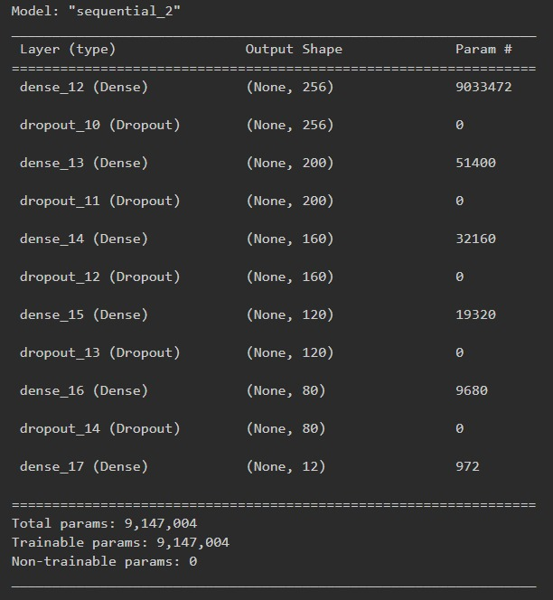
Architecture of Sentiment Analysis DNN

Slide 8
LSTM model
Output
Dense
LSTM
LSTM
Embedding Layer
Embedding Layer
Questions
Answers

Slide 9
Overall architecture for Chatbot
LSTM for topic 1
LSTM for topic 2
Sentiment Classifier
Input message
Output message
LSTM for topic 11
LSTM for topic 12

Slide 10
Sentiment Classifiers trained
Model | Accuracy | Precision | Recall
SVM | 0.6609 | 0.6997 | 0.6751
Logistic Regression | 0.6299 | 0.6104 | 0.6299
SGD | 0.5841 | 0.5820 | 0.5841
DNN | 0.9277 | 0.9444 | -

Slide 11
LSTMs trained
LSTM Topic | Dimension – hyperparameters (vocab size, ip dim1, ip dim2) | Loss
Afraid | 4712, 68, 77 | 0.2127
Angry | 5118, 70, 79 | 0.1444
Annoyed | 5863, 70, 79 | 0.0879
Anticipating | 5729, 69, 78 | 0.1310
Disgusted | 4990, 70, 78 | 0.1450
Faithful | 7051, 68, 76 | 0.0672
Joyful | 3007, 63, 73 | 0.1514
Neutral | 5692, 69, 77 | 0.0808
Proud | 5007, 65, 73 | 0.1385
Sad | 6281, 68, 80 | 0.0698
Sentimental | 2683, 70, 78 | 0.1618
Surprised | 5722, 65, 73 | 0.1387

Slide 12
Datasets used
https://www.kaggle.com/datasets/grafstor/simple-dialogs-for-chatbot
https://www.kaggle.com/datasets/narendrageek/mental-health-faq-for-chatbot
https://www.kaggle.com/datasets/arnavsharmaas/chatbot-dataset-topical-chat
https://www.kaggle.com/datasets/kausr25/chatterbotenglish
https://www.kaggle.com/datasets/atharvjairath/empathetic-dialogues-facebook-ai

Slide 13
Dataset Creation
Data collected from various resources is categorized based on its topic and segregated together as question-answer pair
These question-answer pair have a sentiment associated with them
We grouped these sentiments into 12 categories

Slide 14
Novelties
New sentiment classification-based architecture
Simple LSTM architecture with custom entropy
Comparison and evaluation of different models in text classification for Chatbot
Dataset Creation: Collection and formatting of Question-Answer type data on multiple topics
Analysis of various LSTM archetypes for chatbot prediction

